Slide 1


Structure of the Essay

Slide 2
Structure of the Essay
A traditional essay has 03 parts:
Introduction
Body
Conclusion
A university essay has minimum 05 paragraphs. The maximum number of paragraphs depend on the required length of the
essay.

Slide 3
The introduction and conclusion of the essay are the shorter paragraphs. They are generally 5% of the length of the essay. We usually write 4 – 5 sentences in introductions and conclusions.
The body paragraphs are detailed, as they consist of 6 – 12 sentences each. The structure of the essay can be understood from the following diagram.

Slide 4
Essay Format
Introduction
Thesis Statement
Body
Conclusion

Slide 5
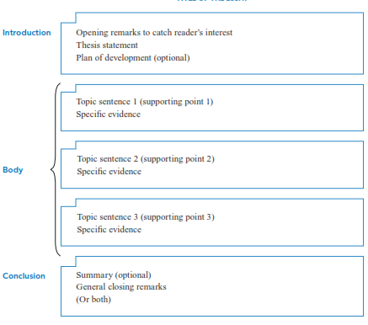

Slide 6
Effective Thesis Statement
The thesis statement is one sentence which gives the readers the main idea of the whole essay.
It is usually placed in the introduction, but it can be written in conclusion.
The thesis statement has two parts:
the central idea
development of the thesis/ preview of the main points

Slide 7
An effective thesis statement Should:
include the development of the thesis
not be too broad
not be too narrow
not be an announcement
not have more than one main idea

Slide 8
The Parts of a Thesis Statement
Topic
Opinion
3 Reasons

Slide 9
The Functions of a Thesis Statement
To announce the topic to the reader
To reflect a judgment about the topic
To provide the reader with a blueprint
of what is to come in the paper

Slide 10
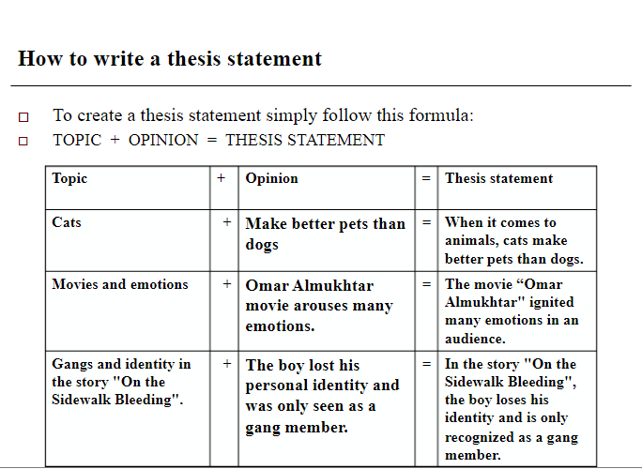

Slide 11
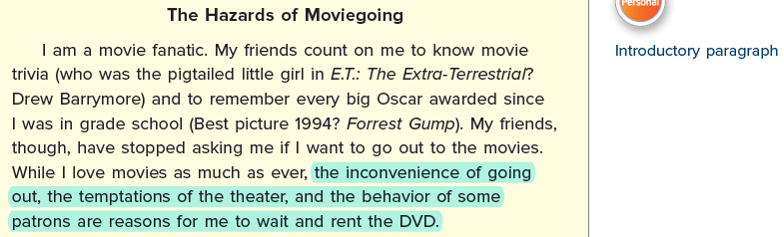
Thesis Statement /
Or main idea

Slide 12
Just like the topic sentence of a paragraph, a good thesis statement does two things. First, it tells readers an essay’s topic. Second, it presents the writer’s attitude, opinion, idea, or point about that topic. For example, look at the following thesis statement:
Owning a pet has several important benefits.
In this thesis statement, the topic is owning a pet; the writer’s main
point is that owning a pet has several important benefits.

Slide 13
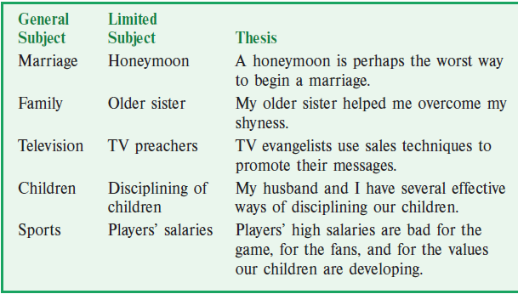

Slide 14
Introduction
First part of an essay
Try to capture the reader’s attention
Introduction Format
1. Attention getter
2. State your problem
3. Bridge or transition sentences
4. Thesis statement (always at the end)

Slide 15
Types of Introduction
General statement
Opposite Idea
Story
Question
Quotation

Slide 16
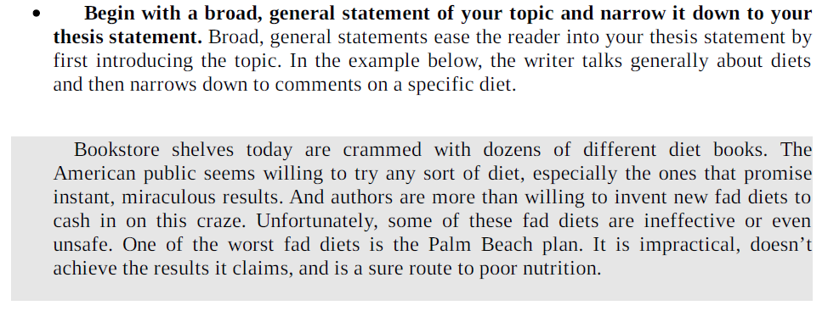

Slide 17
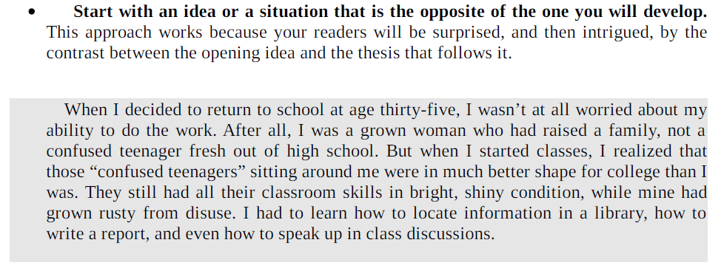

Slide 18
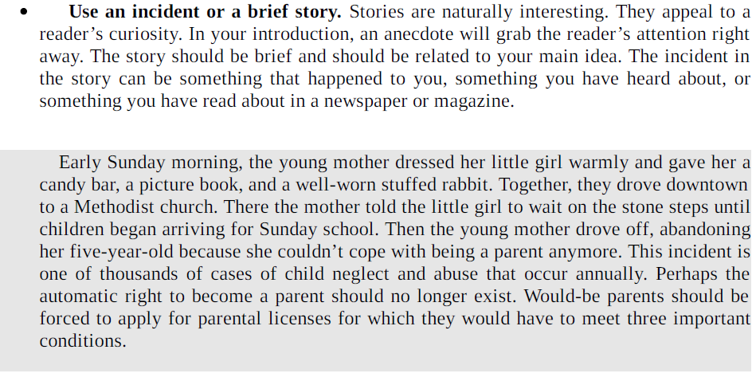

Slide 19
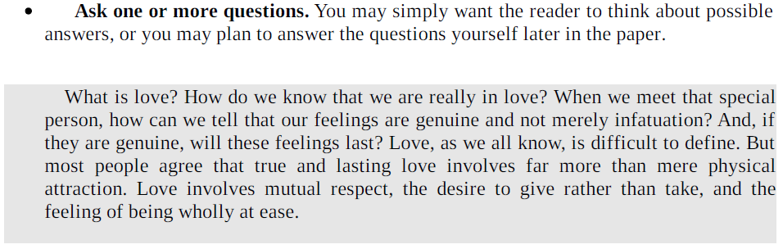

Slide 20
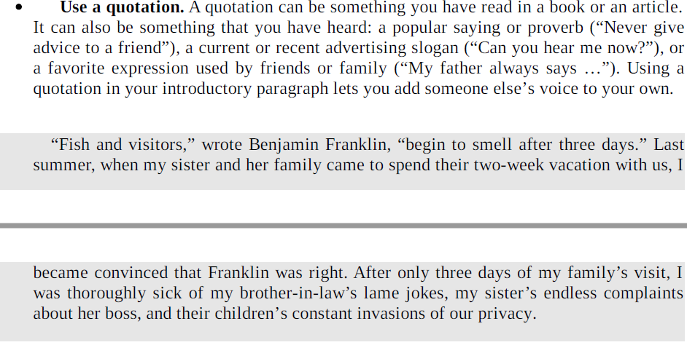

Slide 21
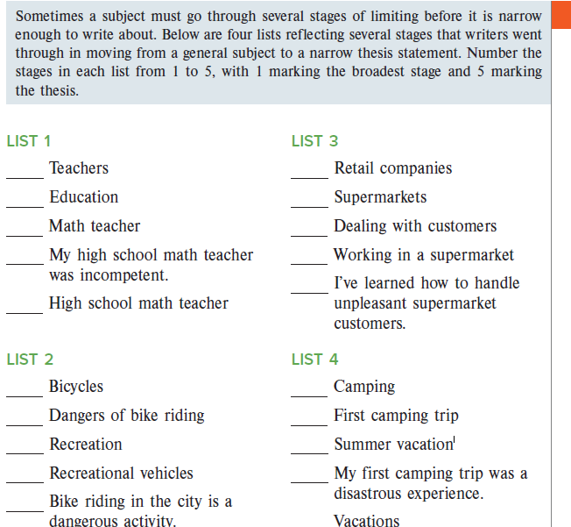

Slide 22
Example of an Introduction
Example
Gnome-Phobia in America
1. In 2004, the Gnome Liberation Front (GLF) was created. This group of people believes that gnomes should be free, not prisoners of their owner’s garden. 2. The GLF has now begun gnome-napping, the act of stealing gnomes and “freeing them” in the wilderness; however, the law is unwilling to do anything. 3. Many police state that the gnomes are not a serious enough offense to deal with and that they have larger crimes to deal with. This is not acceptable. The law should be taking the gnome-napping more seriously because people are committing a crime. 4. Gnome-napping is stealing personal property, and is illegal, morally wrong, and disrespectful.
1. Attention getter
2. State your problem.
3. Bridge or transition sentences
4. Thesis statement
**NOTE: This doesn’t mean your intro is 4 sentences long. It just has 4 parts.

Slide 23
Introduction
Example
I can still remember the beautiful breeze on my face, the smell of the salty air and the sound of crashing waves on the shore. That day Was the most relaxing day of my life. I will never forget the feeling of relaxation that I felt when I went to Jamaica, it was like I had left my world of Frustration and busyness. The beach is such a perfect place to relax for me because of its wonderful weather, the beautiful scenery, and its friendly people.

Slide 24
Body Paragraph
Example
The weather in Jamaica is a perfect relaxation weather. First, it never gets below 80 degrees Fahrenheit, and the breeze is always light and refreshing. Also, It hardly ever rains there and you don’t ever have to worry about snow! In addition, I can relax on the beach and never have to worry about catching a chill at night. It easy to see how the weather makes it so easy to relax on the beach in Jamaica.

Slide 25
Conclusion
Example
In conclusion, I can’t think of any better place to relaxed than the beach. The pleasant weather makes it comfortable all year Around, the scenery has beauty beyond imagination, and people are friendliest I have ever met. Anyone who really needs to relax should consider booking the next flight to the wonderful beaches of Jamaica.

Slide 26
The Body
The body is a set of paragraphs that develop the idea expressed in the thesis statement.
Make a list of main ideas that support the thesis statement. Each main idea becomes the main idea sentence for a body paragraph.
Arrange the main ideas in logical order (time, place, importance)
Plan out each body paragraph by listing major details that support
each main idea
Order the details within each paragraph in a logical way. Each body paragraph may end with a concluding
sentence.

Slide 27
Example Essay Outline
Thesis Statement
Gnome-napping is stealing personal property, and is illegal, morally wrong, and disrespectful.
Body Paragraph 1
Topic Sentence: Gnome-napping is stealing someone’s personal property, and stealing is illegal.
Main Points: 1.
2.
3.
Body Paragraph 2
Topic Sentence: It is morally wrong to take anyone’s property, whether it is a gnome or a car.
Main Points: 1.
2.
3.
Body Paragraph 3
Topic Sentence: The GLF is incredibly disrespectful because they take items that don’t belong them.
Main Points: 1.
2.
3.

Slide 28
The Writing Stage
After planning and arranging your main ideas and major details, begin writing your body paragraphs.
The number of paragraphs depends on the topic’s
complexity, inclusiveness, and your purpose for writing.
Usually a short essay contains 3 to 5 body paragraphs, plus an introduction and conclusion
Remember to use signal words to make smooth
transitions between sentences and paragraphs.

Slide 29
Signal/Transition Words
For examples: For example, for instance, to illustrate
For organization or chronological order: The six steps are…, next, finally first, secondly, third
For additional points: Furthermore, in addition, also, moreover
For opposing ideas: On the other hand, in contrast, although, however
For similar ideas: Likewise, similarly, in comparison

Slide 30
Signal/Transition Words
For exceptions: However, nevertheless, but, yet, still
For emphasis: Above all, finally, more importantly
For understanding: In other words, in essence, briefly
For summarizing: In conclusion, to sum up, for these reasons, in a nutshell
For exams: Remember this, this is important, this could be on the test

Slide 31
Conclusion
Leave the reader thinking about your topic. Leave an impression on them!
No new information in conclusion
Be sure to recap your ideas
Should follow logically from the body of the essay
Restate your thesis statement in different words
You might want to have your reader do something after reading

Slide 33
References
Langan, J. (2011). College writing skills with readings (8th ed.). McGraw Hill.

